Slide 1

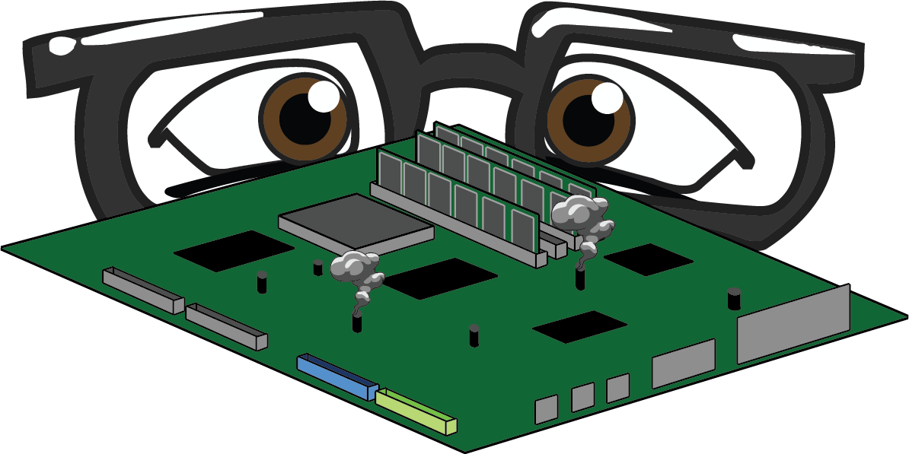
MOTHERBOARD
Notes:
O Logo de espadas deve ter mais espaço das pontas abaixo. Sugerir outros tipos de imagens/ telefone, fones.

Slide 2
CPU
and
power supply
What is a Motherboard ?
Motherboards provides the CIRCUITRY by which all parts of a computer communicate with each other
We install Motherboard inside the ‘computer case’.
Motherboard HOLDS all the components ranging from :
All peripherals and
Expansion cards

Slide 3
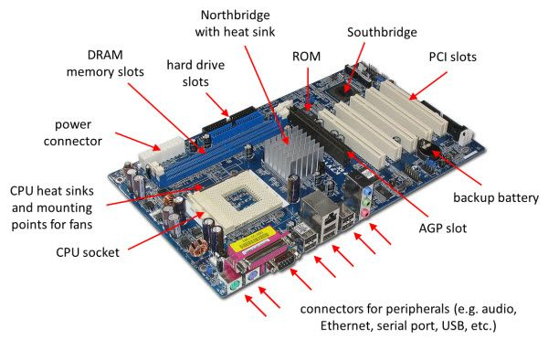

Slide 4
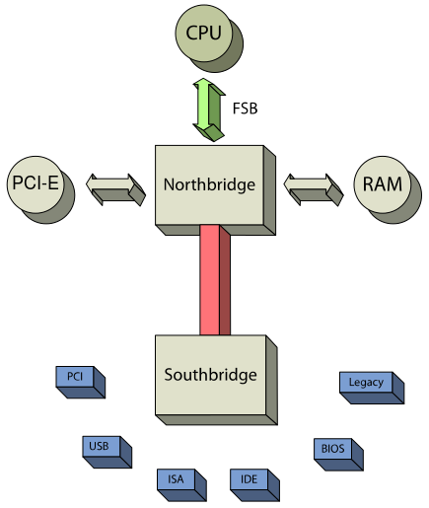
CHIPS : electronic interfaces through which the CPU, RAM, and input/output devices interact.
CHIPSETS : group of microchips to support the CPU’s interfacing with all the other devices on the motherboard.
2 subdivisions of chipsets :
Northbridge
Southbridge
Notes:
Usar para separador de capitulos . Seria bom ter esta versao em vermelho e verde tb..

Slide 5
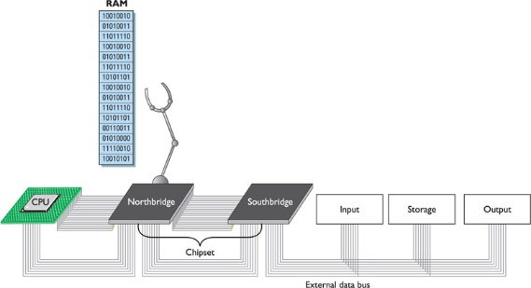
NORTHBRIDGE :
Handles communication between CPU, RAM, Southbridge and high speed graphics ports (AGPs, PCIe)
Memory Controller Hub
SOUTHBRIDGE :
Manages the onboard peripherals (USB ports, PCI bus, LAN card, Hard Drives)
Input/Output Controller Hub

Slide 6
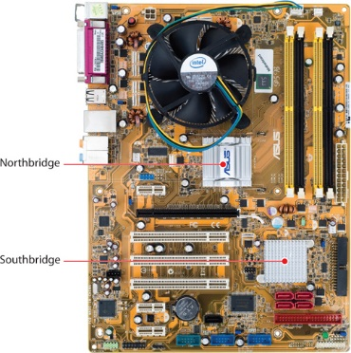
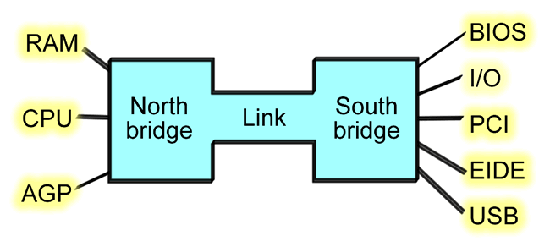
Snapshot of prominent Northbridge & Southbridge on the Motherboard.
But nowadays, Northbridge is coming integrated into the CPU.
TO SUMMARIZE :

Slide 7
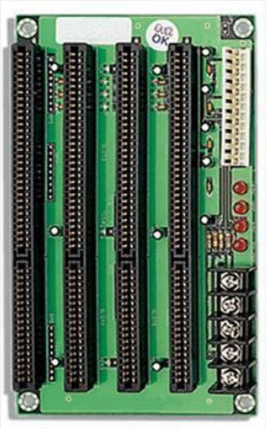
Expansion Slots Types :
1. ISA
Industry Standard Architecture
Very Old ? => Then why it is still there on motherboard ? => LEGACY
Typically black
ISA slots have 2 different sized sections – speed scalability
Notes:
Fixar a posicao do titulo – sempre do lado esquerdo.
Sempre que tiver muito texto o coluna deve sempre ser “ narrowed” , se nao fica dificil de ler. Colocar paragrafos no texto.
Linha vertical deve ser mais fina e as pontas NUNCA devem ser arredondadas.

Slide 8
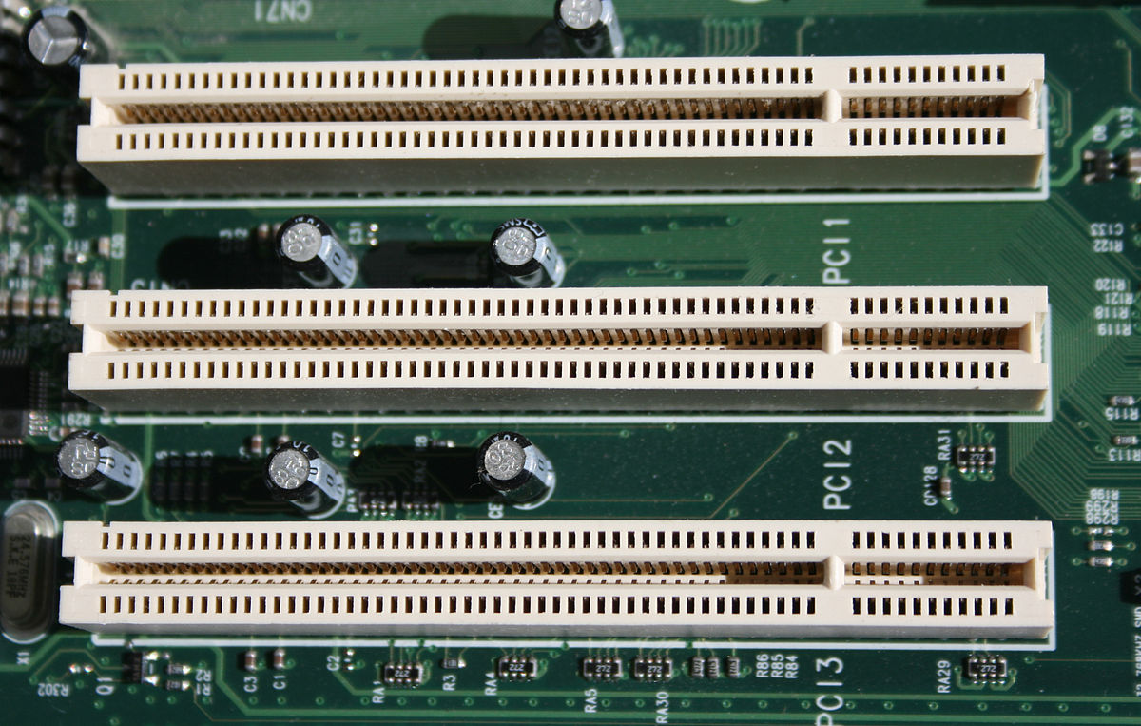
2. PCI
Peripheral Component Interconnect.
Older version of PCIe.
Developed by Intel as a faster alternative to the deprecated ISA bus.
Typically white in color.
Slot for older expansion cards such as sound cards, network cards, connector cards.
PCI bus has 32 bit and 64 bit variants:
Initially had 32 bit data path, and supported 5 volts of power.
Later enhanced to 64 bits and 3.3 volts.

Slide 9
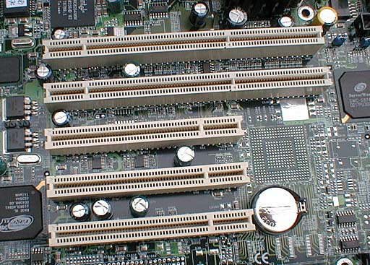
3. PCI-X
Peripheral Component Interconnect EXTENDED.
PCI-X improved upon the PCI bus for use in servers.
Enhances the PCI standard with wider data paths & faster paths.
Typically implemented in servers with a need for higher performance.
Backwards compatible with PCI.
We had it on workstations but mostly it has been phased out.

Slide 10
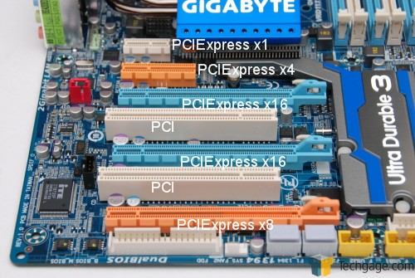
4. PCI-E (PCIe)
Peripheral Component Interconnect EXPRESS.
Successor to traditional PCI bus but substantially faster.
Connects to either Northbridge or Southbridge.
Uses lanes : (Lanes are full duplex)
PCIe 1x
PCIe 4x
PCIe 8x ……. Least common
PCIe 16x …... Video Card
Physical slot size determines compatibility : 1x can go into a 1x size or larger
Format on Motherboard : PCIEX16

Slide 11
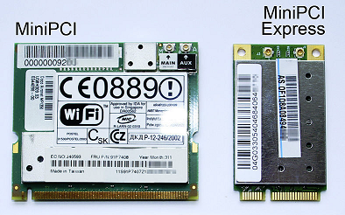
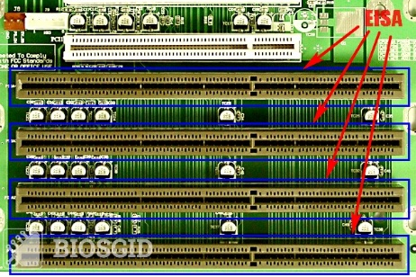
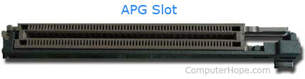
5. Mini PCI and Mini PCIe
Specifically for use in laptops.
This is used to add WIFI, Bluetooth and SCSI or similar functionality to laptops.
6. EISA slot
Extended Industry Standard Architecture.
Extends ISA from 16 bits to 32 bits.
Backwards compatible with ISA bus.
7. AGP slot
Accelerated Graphics Port.
AGP is an advanced port designed for video cards and 3D accelerators.
Developed by Intel, AGP introduces a dedicated point-to-point channel that allows the graphics controller direct access to the system memory.
The AGP channel is 32-bit wide and runs at
66 MHz.

Slide 12
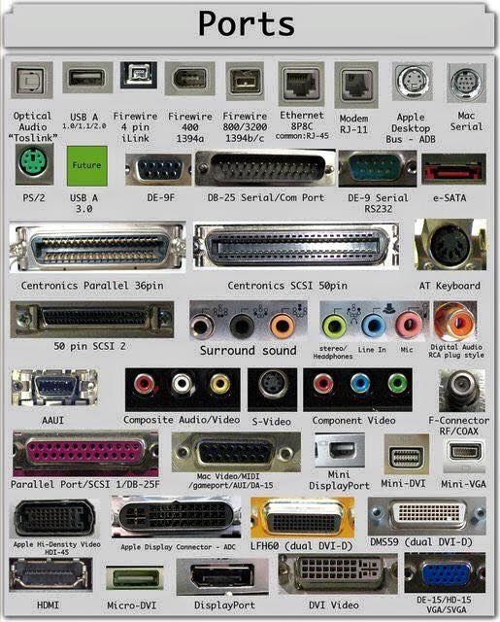
Computer Ports
Serial Port
Parallel Port
USB Port

Slide 13
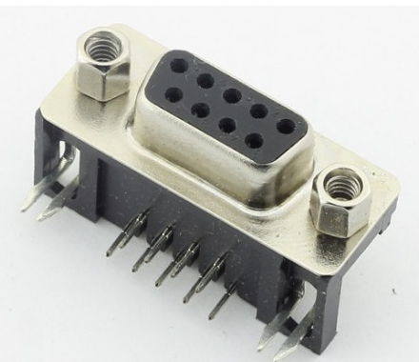
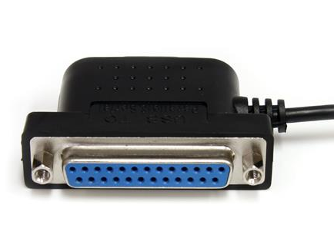
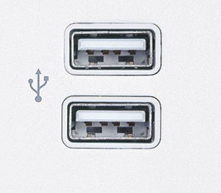
 | PORTS
 | SERIAL | 9 pin connector to connect serial mouse. Allow only 1 bit at a time. Used to connect communication device (COM Port). Maximum data rate is 115 Kbps.
 | PARALLEL | Allow 1 byte (8 bit) at a time. 25 pin female port to connect printer, scanner and external devices. It moves data at speed of about 1 Mbps.
 | USB | Universal Serial Bus. Supports upto 127 devices. Formerly with 1.2 Mbps, it was improved to full speed, 12 Mbps. (USB 2.0 – more than 400 Mbps)

Slide 14
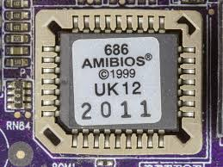
BIOS
BASIC INPUT OUTPUT SYSTEM
During the startup process, information about the hardware is provided by a microchip on the motherboards called the BIOS.
It is a firmware – in between hardware and software.
BIOS is stored on ROM chips on the motherboard.

Slide 15
Working of BIOS
When we turn on your computer, the BIOS does several things (in sequence) :
Check the CMOS Setup for custom settings
Load the interrupt handlers and device drivers
Initialize registers and power management
Perform the power-on self-test (POST)
Display system settings
Determine which devices are bootable
Initiate the bootstrap sequence

Slide 16
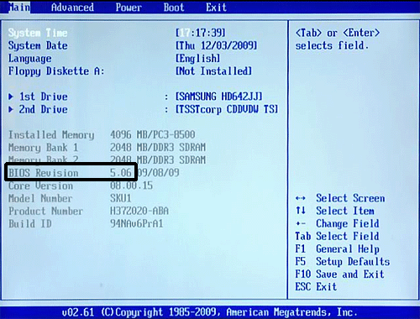
BIOS Screen
To enter the CMOS Setup, you must press a certain key or combination of keys during the initial startup sequence. Most systems use Esc, Del, F1, F2, Ctrl-Esc or Ctrl-Alt-Esc to enter setup. There is usually a line of text at the bottom of the display that tells you Press ___ to Enter Setup.

Slide 17
BIOS Settings
Once you have entered setup, you will see a set of text screens with a number of options. Some of these are standard, while others vary according to the BIOS manufacturer. Common options include:
System Time/Date - Set the system time and date
Boot Sequence - The order that BIOS will try to load the operating system
Plug and Play - A standard for auto-detecting connected devices; should be set to "Yes" if your computer and operating system both support it

Slide 18
Mouse/Keyboard - "Enable Num Lock," "Enable the Keyboard," "Auto-Detect Mouse"...
Drive Configuration - Configure hard drives, CD-ROM and floppy drives
Memory - Direct the BIOS to shadow to a specific memory address
Security - Set a password for accessing the computer
Power Management - Select whether to use power management, as well as set the amount of time for standby and suspend
Exit - Save your changes, discard your changes or restore default settings

